Slide 1
Introduction to Dimensional Modeling II
Chapter 3 and Chapter 4

Slide 2
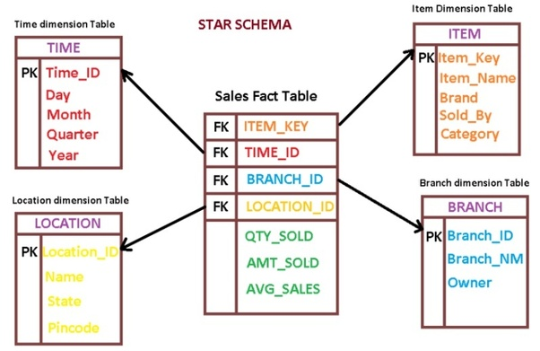
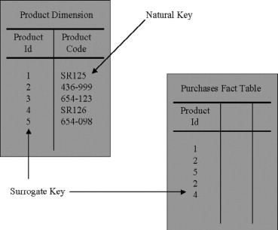
Dimension and Fact Table Keys
Dimension Table Surrogate Keys
Unique primary key of a dimension table (meaningless keys, integer keys, non-natural keys, artificial keys, and synthetic keys);
Simply integers that are assigned sequentially as needed to populate a dimension;
Denoted as PK in the table;
Used for Joins between dimension and fact tables in the data warehouse;

Slide 3
Dimension and Fact Table Keys
Advantages of using Surrogate Keys as PK:
1. Buffer the data warehouse from operational changes.
2. Integrate multiple source systems.
3. Improve performance.
4. Handle null or unknown conditions.
5. Support dimension attribute change tracking.

Slide 4
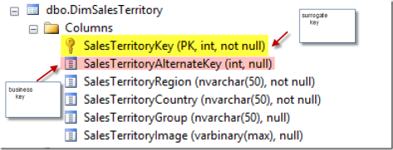
Dimension and Fact Table Keys
Dimension Natural Keys
Assigned and used by operational source systems;
Handled as a dimension attribute/attributes
Business keys, production keys, and operational keys;
Denoted as NK;
If the natural key comes from multiple sources: character data type that prepends a source code, such as SAP|43251 or CRM|6539152

Slide 5
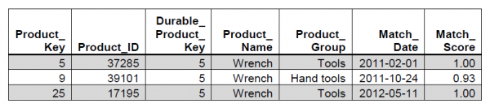
Dimension and Fact Table Keys
Supernatural keys
If the dimension’s natural keys are not absolutely protected and preserved over time, the ETL system needs to assign permanent durable identifiers;
Durable supernatural key
Controlled by the DW/ BI system and remains immutable for the life of the system;
A simple integer sequentially assigned;
Handled as a dimension attribute;

Slide 6
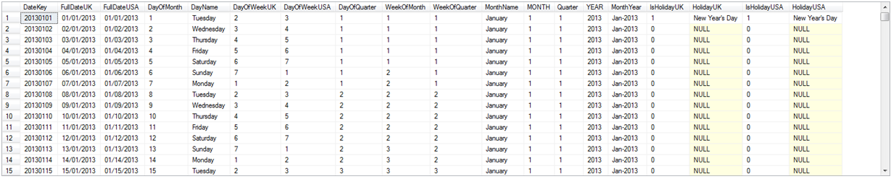
Dimension and Fact Table Keys
Date Dimension Smart Keys
Using a smart yyyymmdd key provides the benefits of a surrogate;
Easier partition management;

Slide 7
Fact Table Surrogate Keys
Fact table surrogate keys, which are not associated with any dimension, are assigned sequentially during the ETL load process:
1) as the single column primary key of the fact table;
2) to serve as an immediate identiﬁer of a fact table row without navigating multiple dimensions for ETL purposes;
3) to allow an interrupted load process to either back out or resume;
4) to allow fact table update operations to be decomposed into less risky inserts plus deletes;

Slide 8
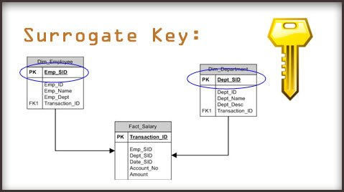
Fact Table Surrogate Keys

Slide 9
Basic Dimension Table Techniques
Snowflaked Dimensions
When a hierarchical relationship in a dimension table is normalized, low-cardinality attributes appear as secondary tables connected to the base dimension table by an attribute key.
A characteristic multilevel structure is created that is called a snowflake.
Should avoid snowflakes:
it is difficult to understand and navigate snowflakes;
Negatively impact query performance;

Slide 10
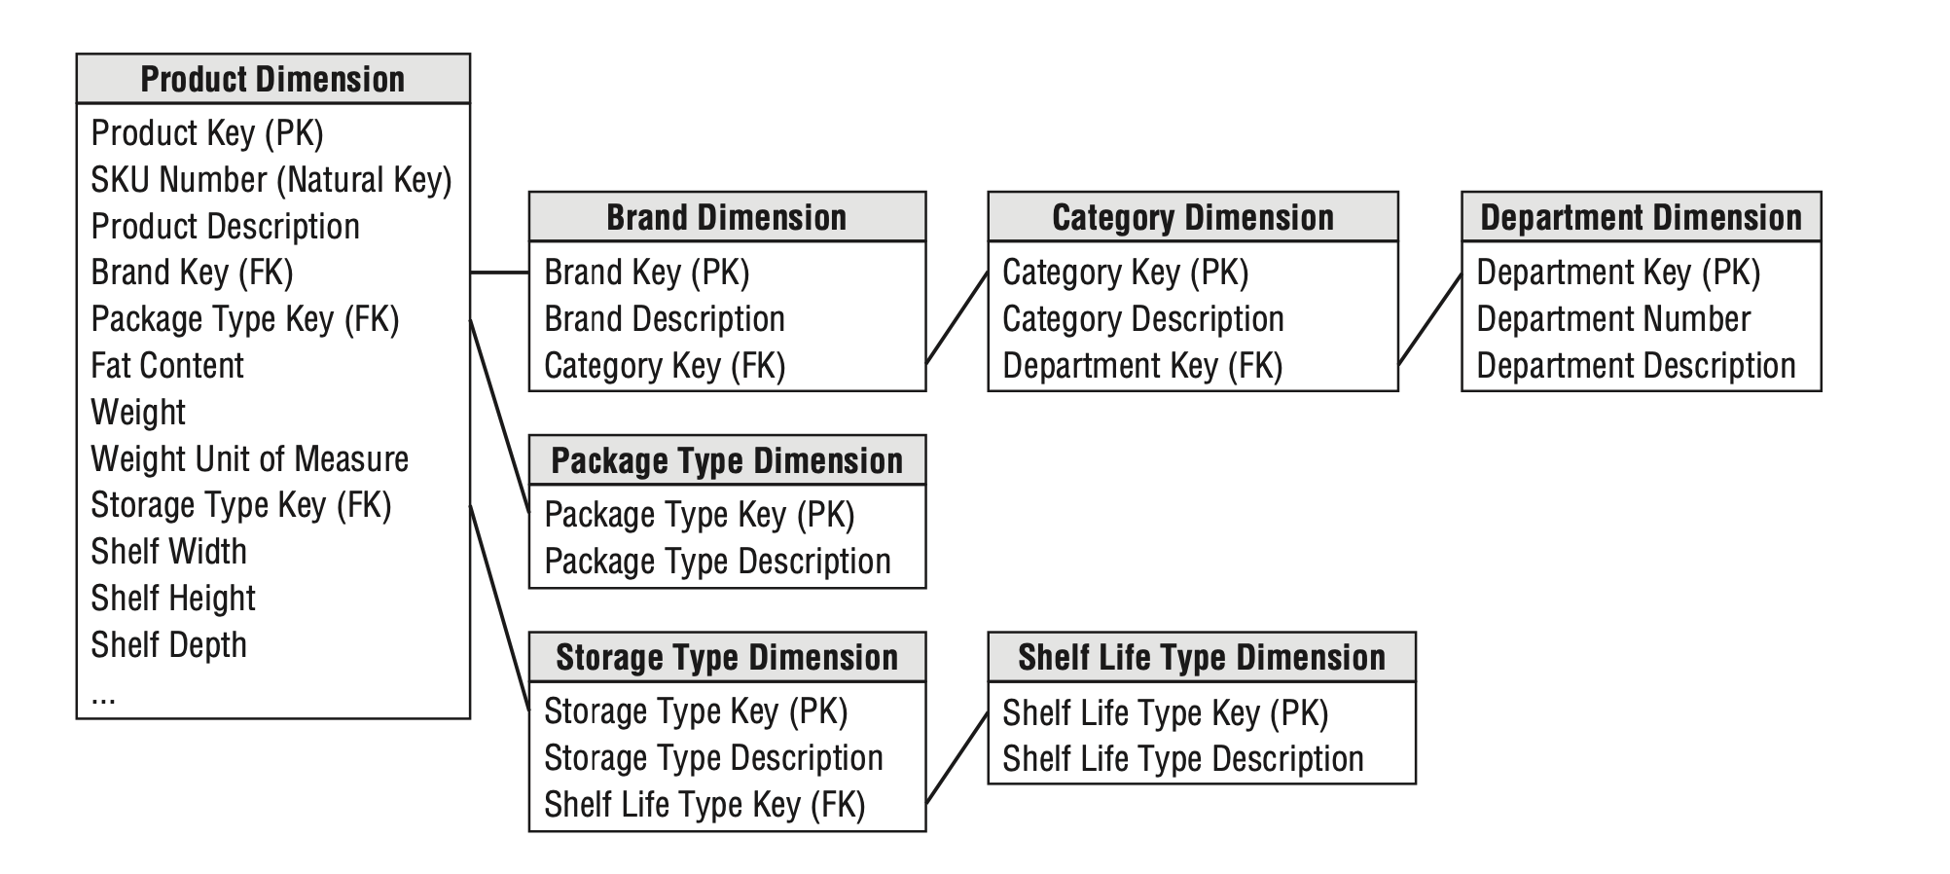
Retail Case Study
Snowflaked Dimensions
A much more complex presentation
Slower query performance.
Insignificant disk space savings.
Negatively impacts the users’ ability to browse within a dimension.

Slide 11
Comparison
Snowflaked
Star
Central fact table
Normalized dimension tables
More storage efficiency
Rigid data model
Lots of overhead upon initial setup
Easier to Update
Central fact table
Denormalized dimension tables
Easier to design
Data redundancy (duplication of data)
Faster Query Performance
Difficult to update

Slide 12
Basic Dimension Table Techniques
Outrigger Dimensions
A dimension can contain a reference to another dimension table.
The secondary dimension references are called outrigger dimensions.
Bank account dimension refer to a separate dimension representing the open date the account.
More often, the correlations between dimensions should be demoted to a fact table, where both dimensions are represented as separate foreign keys.

Slide 13
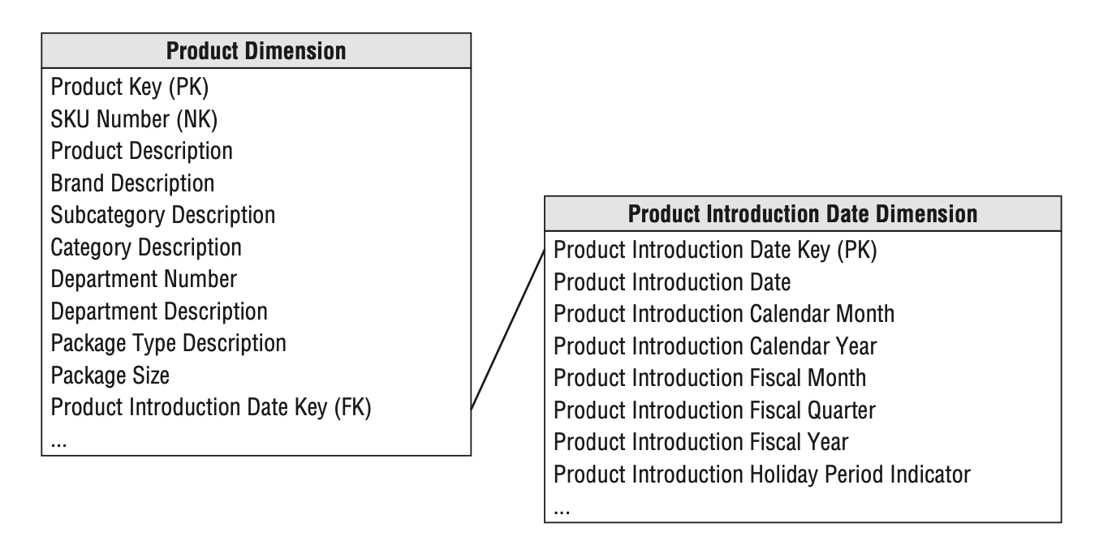
Retail Case Study
Outriggers
Save Space and ensure consistent attributes reference;
Introduce more joins, which can negatively impact performance;
Difficult to browse the attributes within a single dimension;
Large number of attributes;
Different grain;
Different update frequency;

Slide 14
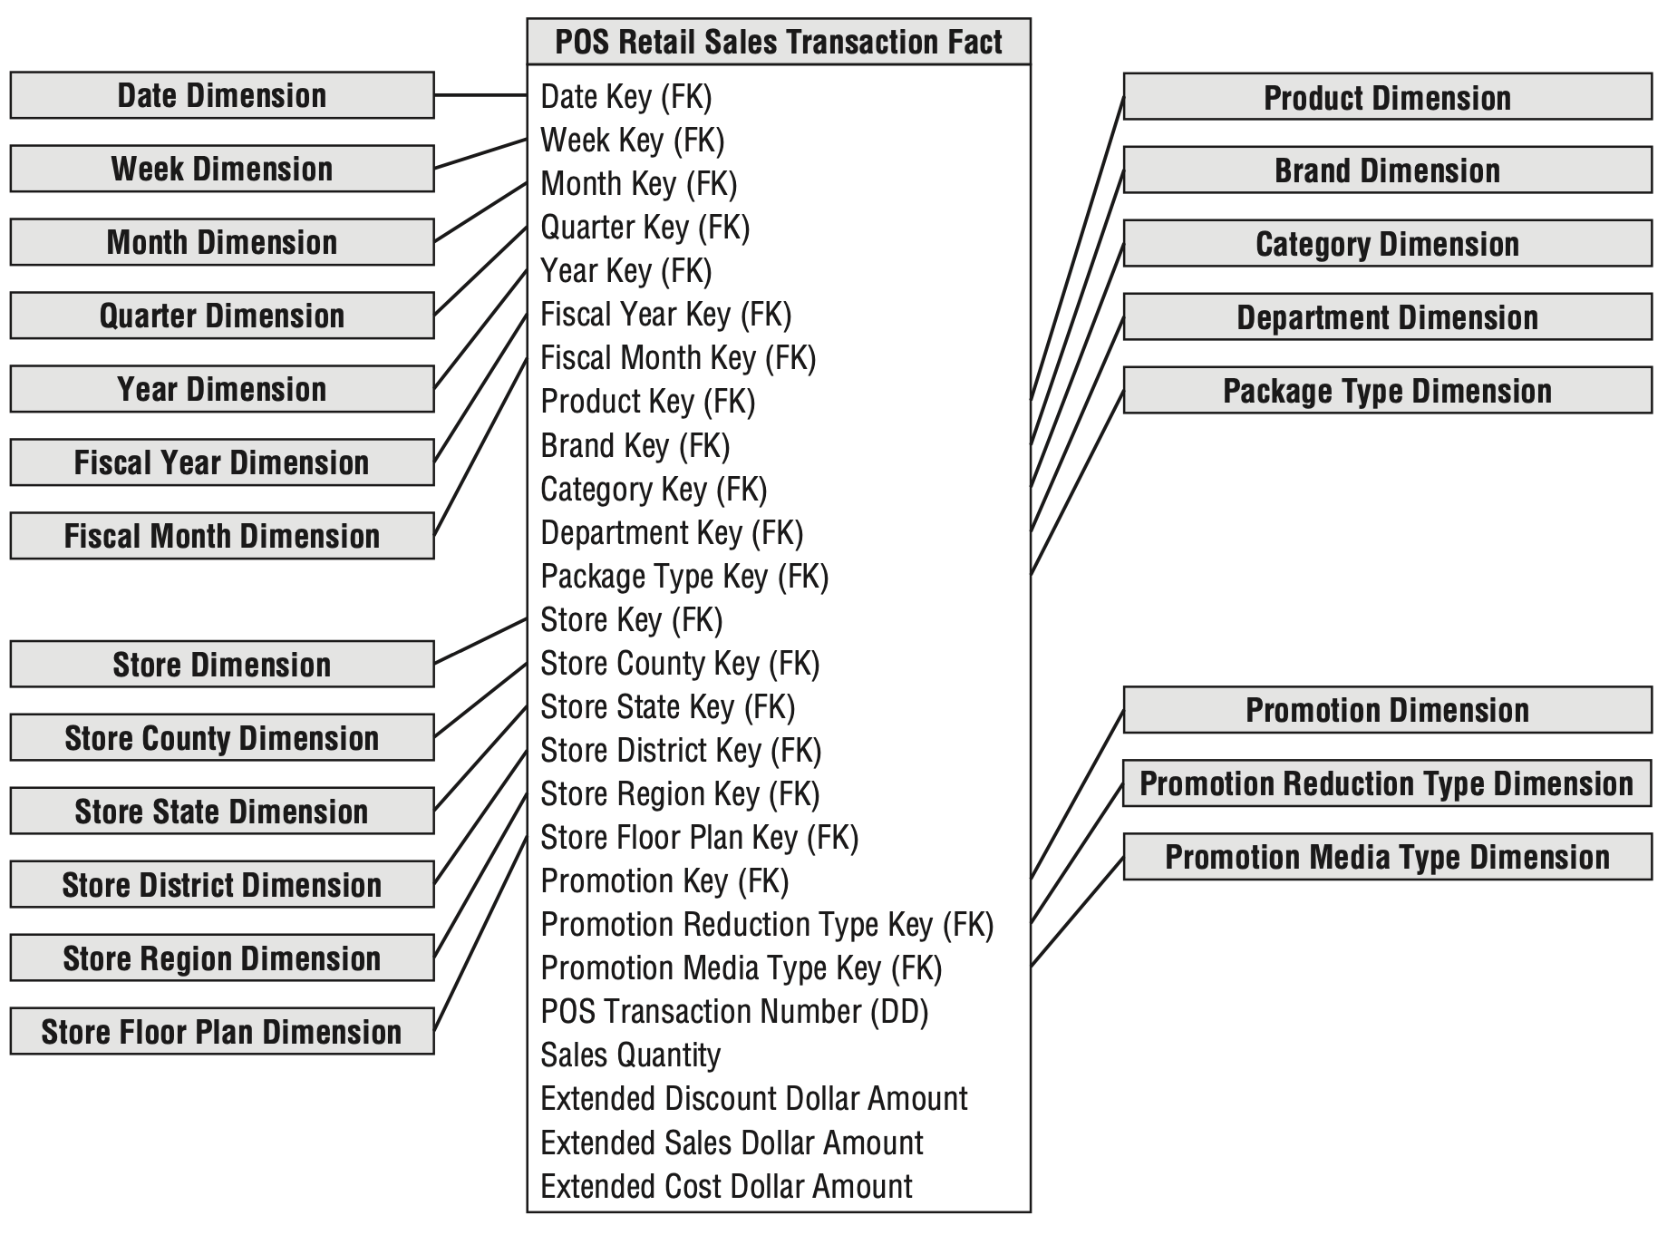
Basic Dimension Table Techniques
Centipede Fact Tables with Too Many Dimensions
Denormalize the dimension table;
The normalized tables end up joined to the fact table;
The fact table include foreign keys for the frequently analyzed elements on the product hierarchy, such as brand, category, and department.
Most business processes can be represented with less than 20 dimensions in the fact table.

Slide 15
Graceful Extensions to Dimensional Models
Dimensional models are resilient when data relationships change.
Facts can be added by creating new columns;
Dimensions can be added to an existing fact table by creating new foreign key columns;
Attributes can be added to an existing dimension table by creating new columns;
The grain of a fact table can be made more atomic by adding attributes to an existing dimension table, and then restating the fact table at the lower grain;

Slide 16
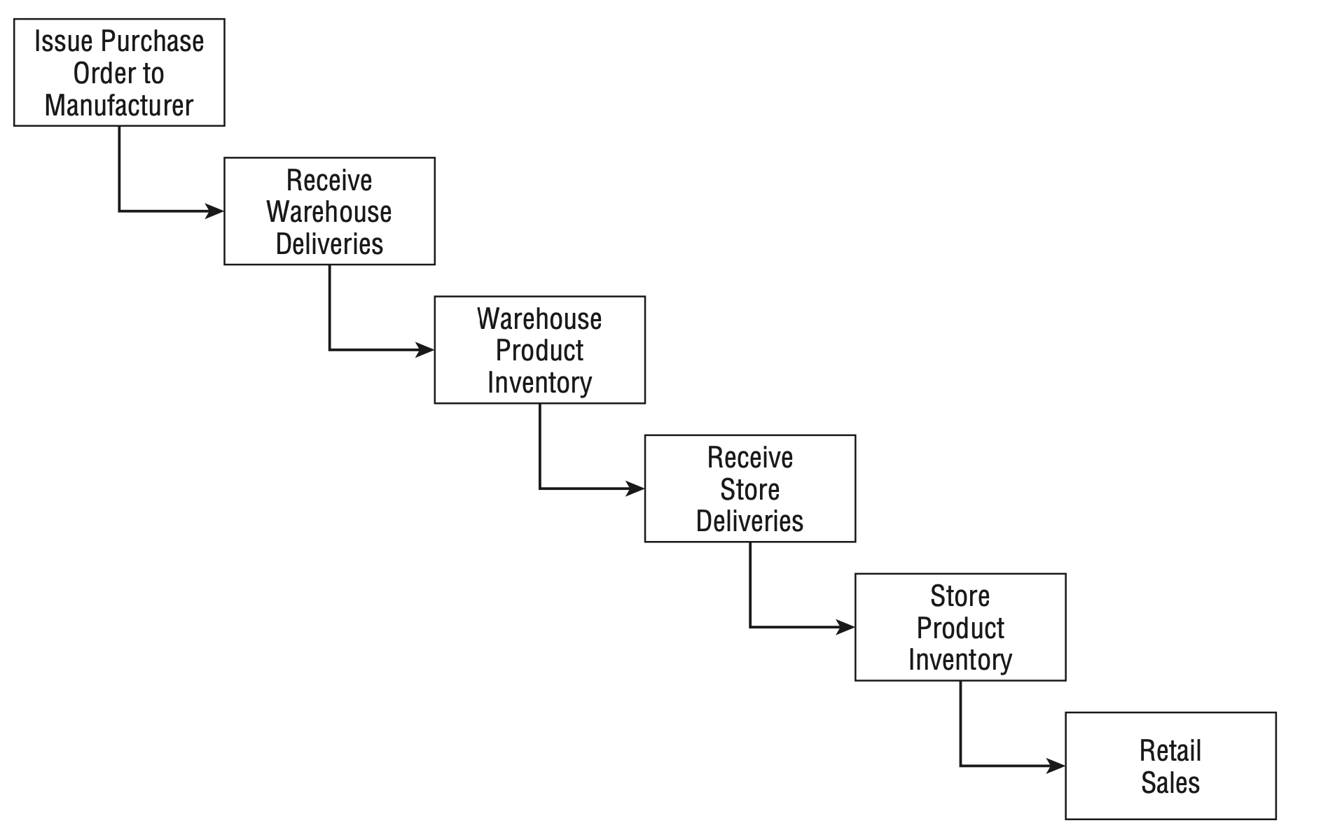
Organizational Value Chains
There is an underlying value chain of key business processes;
A value chain is a set of activities that a firm operating in a specific industry performs in order to deliver a valuable product (i.e., good and/or service) for the market.

Slide 17
Organizational Value Chains
The primary objective of most analytic DW/BI systems is to monitor the performance results of these key processes.
Each process typically spawns one or more fact tables.
The value chain provides high-level insight into the overall data architecture for an enterprise DW/BI environment.

Slide 18
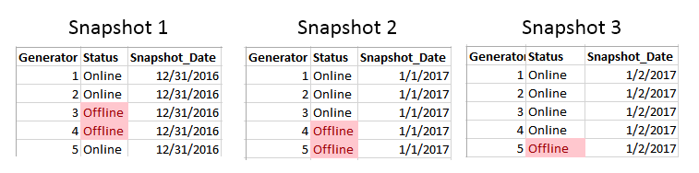
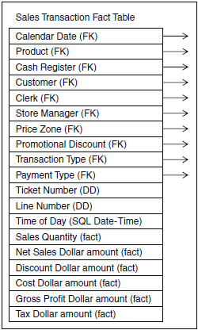
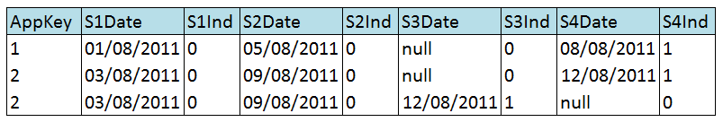
Three Fact Table Types
Periodic Snapshots;
Transaction;
Accumulating Snapshots;

Slide 19
Transaction Fact Tables
A row in a transaction fact table corresponds to a measurement event at a point in space and time.
Atomic transaction grain fact tables are the most dimensional and expressive fact tables;
Transaction fact tables may be dense or sparse because rows exist only if measurements take place.
The fact tables always contain a foreign key for each associated dimension
Contain precise time stamps and optionally degenerate dimension keys.
The measured numeric facts must be consistent with the transaction grain.

Slide 20
Inventory Transactions
Record every transaction that affects inventory to model an inventory business process:
Receive product. Place product in bin. Pick product from bin. Package product for shipment. Ship product to customer. Receive product from customer. Remove product from inventory….
Inventory Transaction Fact Tables:
Is useful for measuring the frequency and timing of specific transaction types;
The granularity is one row per inventory transaction;
Each inventory transaction identifies the date, product, warehouse, vendor, transaction type, the inventory quantity impact caused by the transaction.
Will contain multiple tables, if transactions’ dimensionality varies by event;

Slide 21
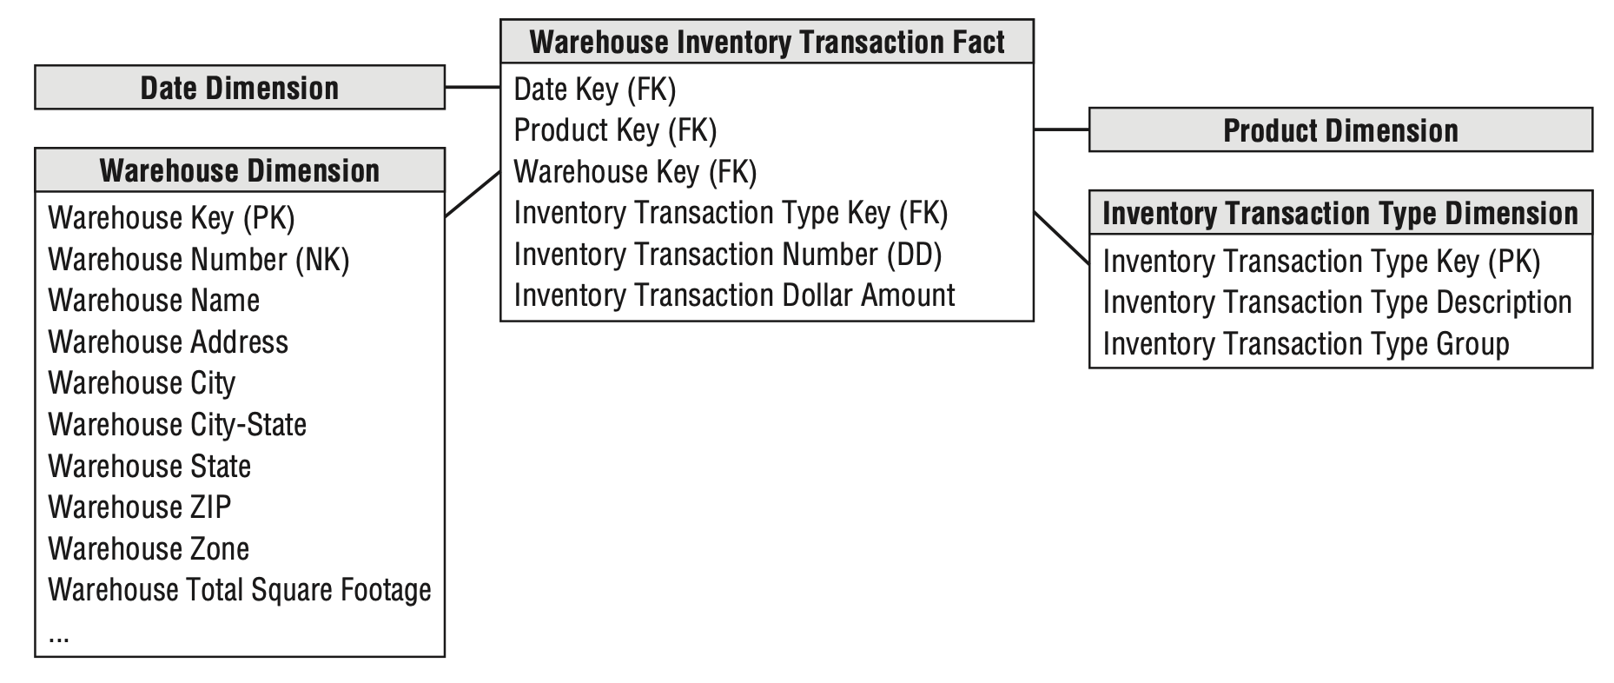
Inventory Transactions

Slide 22
Periodic Snapshot Fact Tables
A row in a periodic snapshot fact table summarizes many measurement events occurring over a standard period, such as a day, a week, or a month.
The grain is the period, not the individual transaction.
Often contain many facts because any measurement event consistent with the fact table grain is permissible.
These fact tables are uniformly dense in their foreign keys
Even if no activity takes place during the period, a row is typically inserted in the fact table containing a zero or null for each fact.

Slide 23
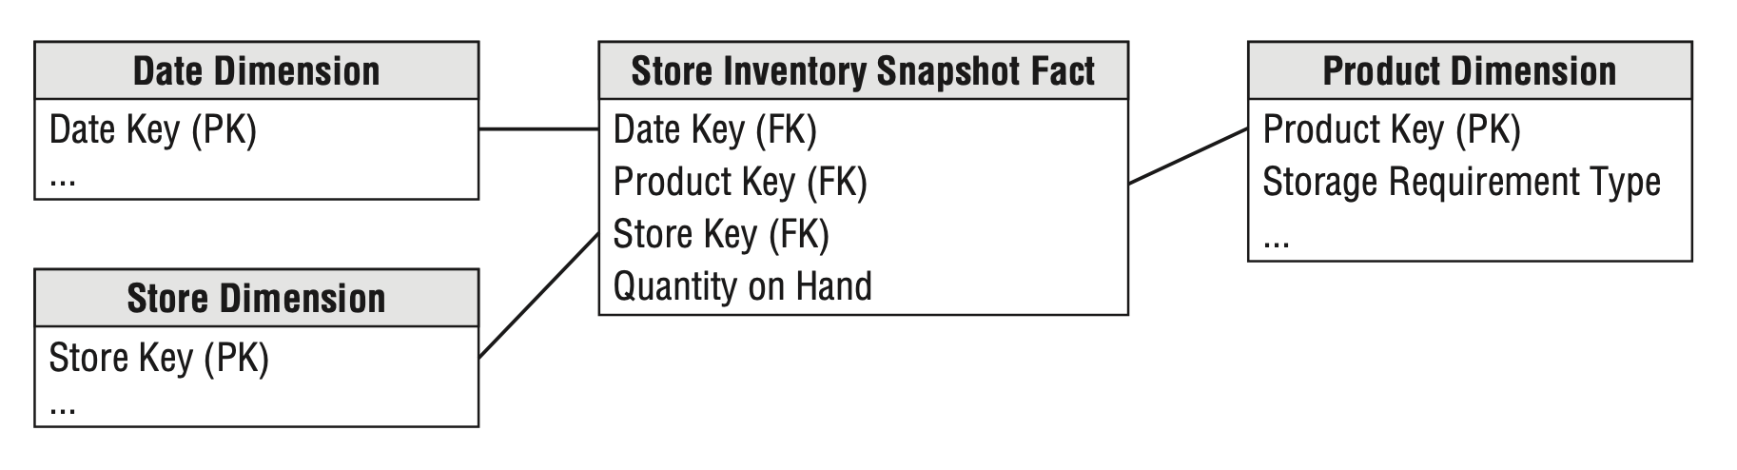
Inventory Periodic Snapshot (the most common inventory schema)
The most atomic level of detail provided by the operational inventory system is a daily inventory for each product in each store.
The simplest view of inventory involves only a single fact: quantity on hand.
Challenge: Inventory generates dense snapshot tables.
There may be a row in the fact table for every product in every store every day.

Slide 24
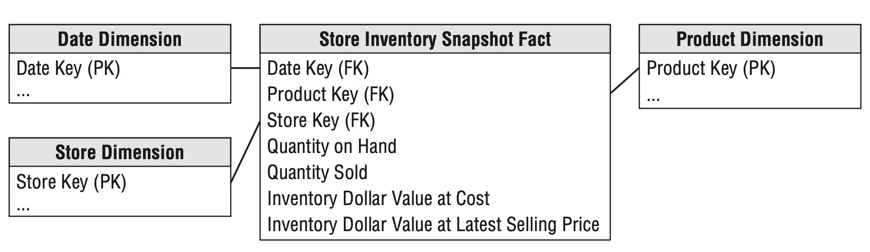
Additional Fact Techniques
Semi-Additive Facts
Semi-additive measures can be summed across some dimensions, but not all;
The quantity on hand can be summarized across products or stores and result in a valid total.
Enhanced Inventory Facts

Slide 25
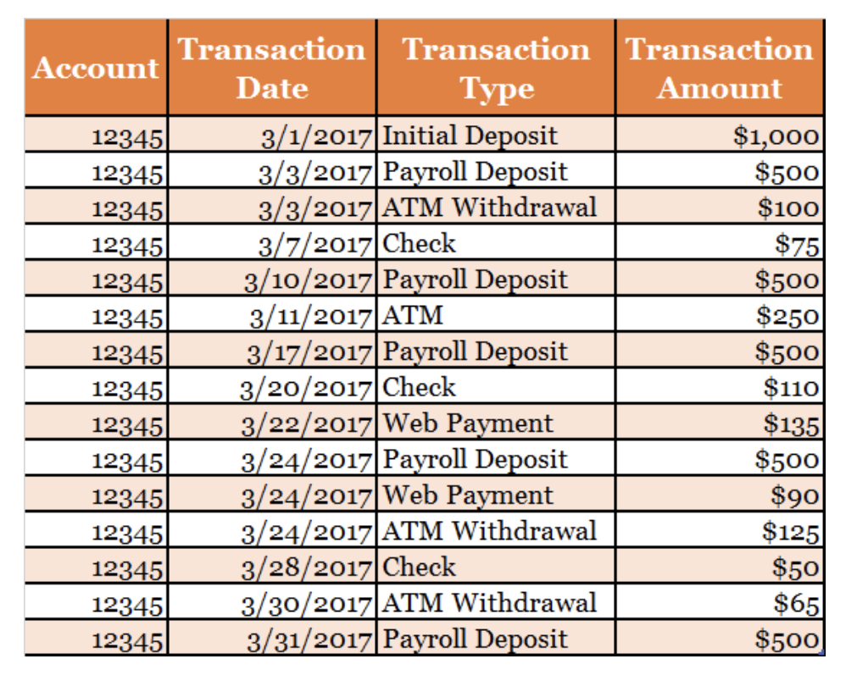
Periodic Snapshot Fact Tables and Transactional fact table Comparison
Transactional fact table
Transactional fact tables capture the measurement at its most atomic dimensional level, at the point-in-time of the transaction.

Slide 26
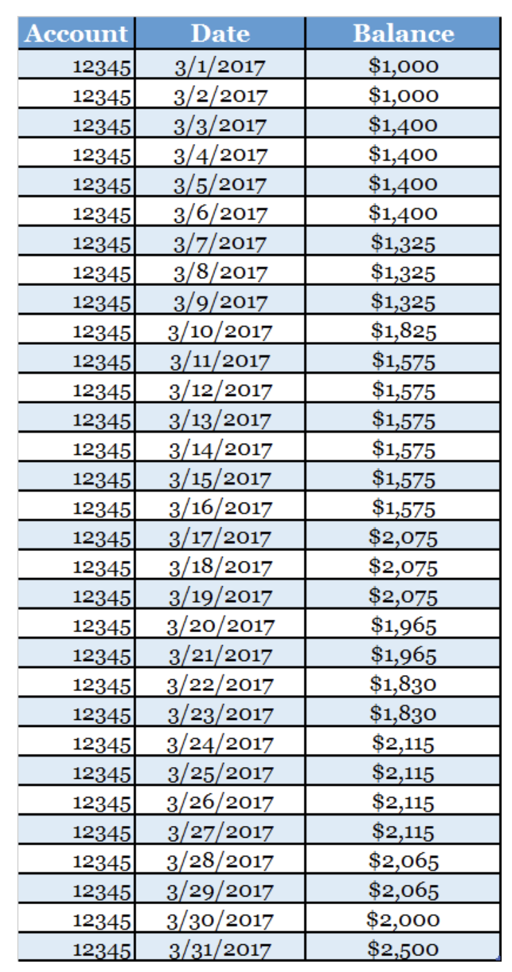
Periodic Snapshot Fact Tables and Transactional fact table Comparison
Snapshot Fact Tables:
Snapshot fact tables capture the state of the measures based on the occurrence of a status event or at a specified point-in-time or over specified time intervals (day, week, month, quarter, year, etc.).

Slide 27
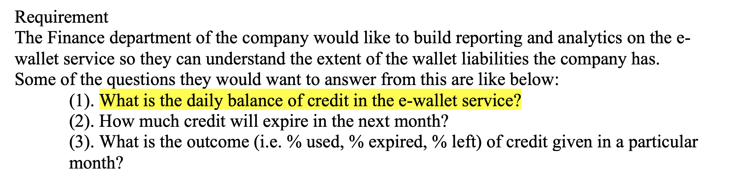
Lab 1 Question 1
Snapshot Fact Tables (daily)
Column | Description
DateID | Date id refer to date dimension
WalletID | Wallet id refer to wallet dimension
Balance | Balance left for each account

Slide 28
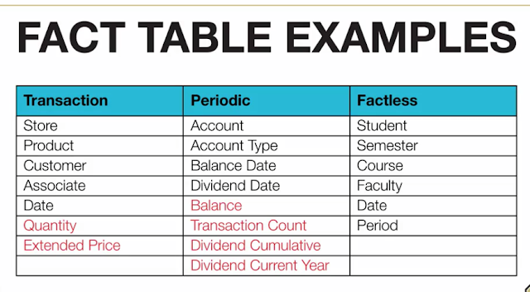
Common Fact Table Examples
Types Of Fact Tables:-
Transaction:
Most Common.
Usually additive measures.
Snapshot:
Periodic or accumulating.
Usually semi-additive.
Factless:
Event Occurrence.
No measures, just FKs.

Slide 29
Accumulating Snapshot Fact Tables
A row in an accumulating snapshot fact table summarizes the measurement events occurring at predictable steps between the beginning and the end of a process.
Pipeline or workﬂow processes, such as order fulﬁllment or claim processing (a deﬁned start point, standard intermediate steps, and deﬁned end point)
There is a date foreign key for each critical milestone in the process.
An individual row is initially inserted when the order line is created.
As pipeline progress occurs, the accumulating fact table row is revisited and updated.
Often include numeric lag measurements consistent with the grain, with milestone completion counters.

Slide 30
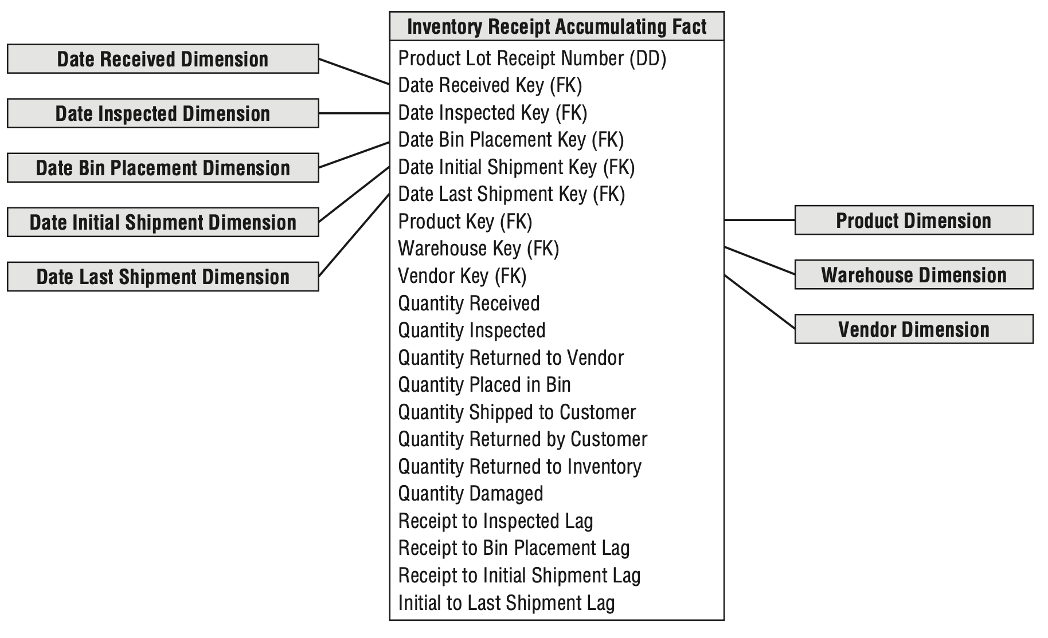
Inventory Accumulating Snapshot
Inventory levels for a product lot captured a series of events or milestones as it moves through the warehouse, such as receiving, inspection, bin placement, and shipping.

Slide 31
Lags Between Milestones and Milestone Counts
The fact table typically contains metrics representing the durations or lags between key milestones.
Accumulating snapshot fact tables sometimes include milestone completion counters, valued as either 0 or 1.
Accumulating snapshots often have a foreign key to a status dimension, which is updated to reflect the pipeline’s latest status.

Slide 32
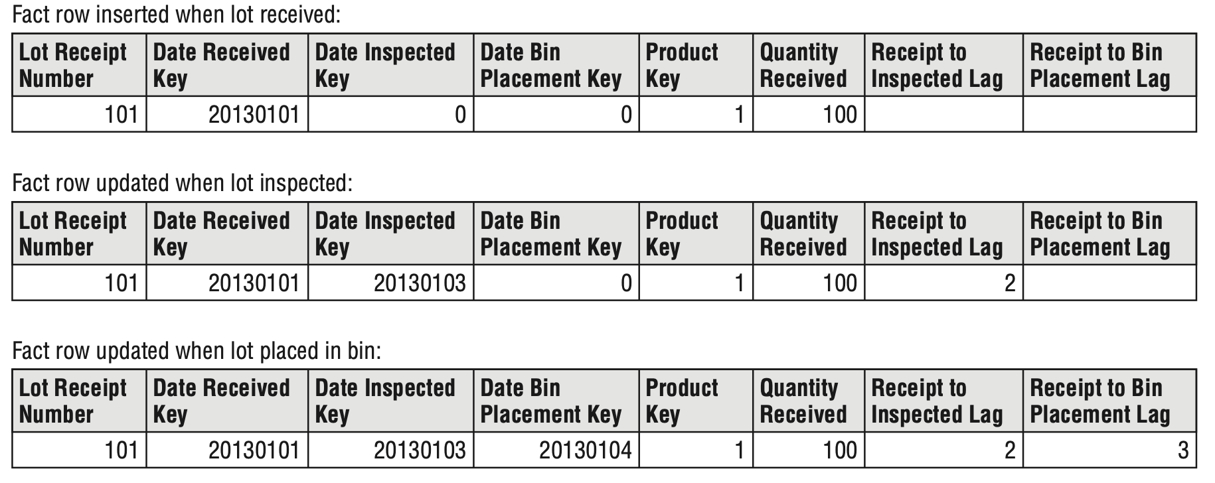
Inventory Accumulating Snapshot
The accumulating snapshot fact table provides an updated status of the lot as it moves through standard milestones represented by multiple date-valued foreign keys.
Each accumulating snapshot fact table row is updated repeatedly until the products received in a lot are completely depleted from the warehouse;

Slide 33
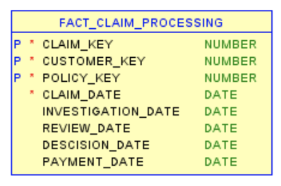
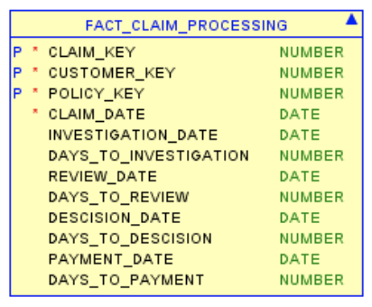
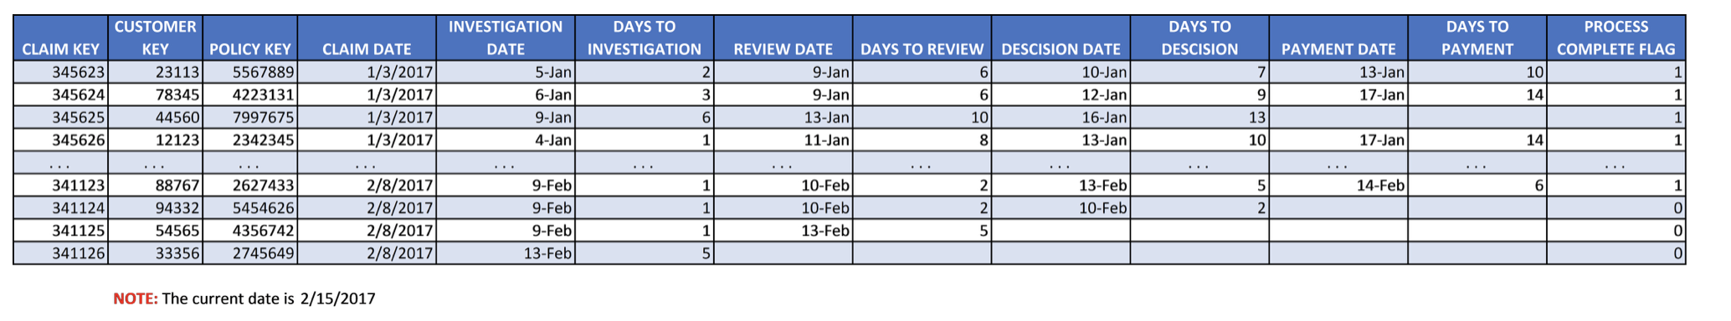
More examples of Accumulating Snapshot
Claim Processing
Lags

Slide 34
Accumulating snapshot tables are helpful when:
Accumulating snapshot tables are helpful when:
You are studying the time between linear and predictable milestones
You are looking to avoid the complexity of correlated subqueries or the possible performance issues of drilling across fact tables.

Slide 35
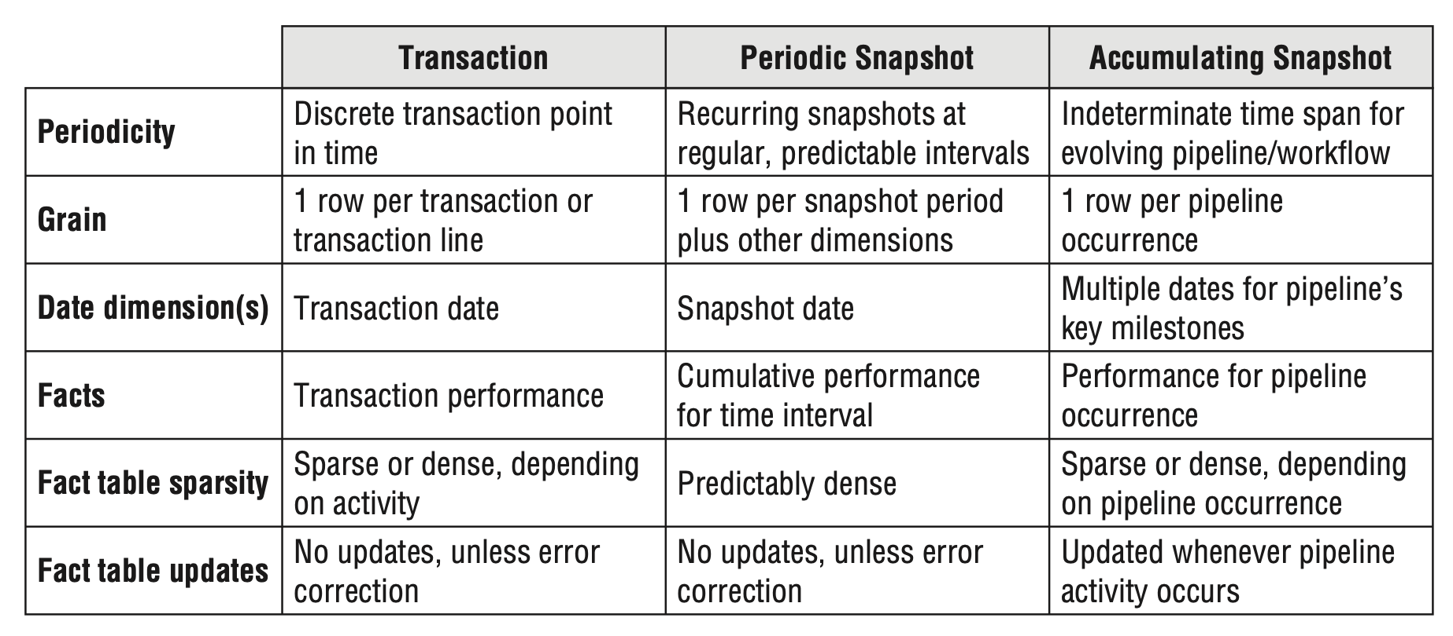
Fact Table Types Comparison

Slide 36
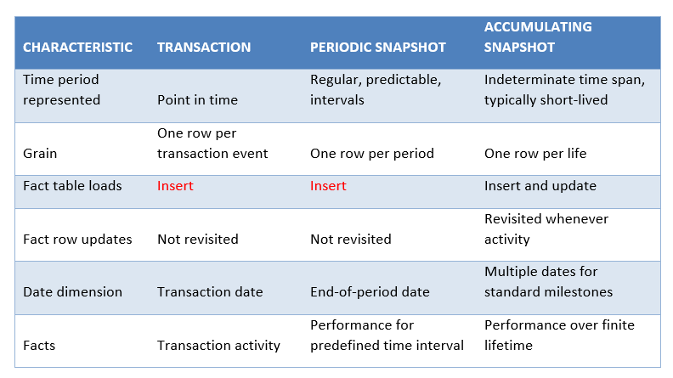
Fact Table Types Comparison cont.

Slide 37
Complementary Fact Table Types
Accumulating and periodic snapshots work in conjunction with one another;
When you incrementally build the monthly snapshot by adding the effect of each day’s transactions to a rolling accumulating snapshot while also storing 36 months of historical data in a periodic snapshot.
Transactions and snapshots are the yin and yang of dimensional designs.
Used together, companion transaction and snapshot fact tables provide a complete view of the business.

Slide 38
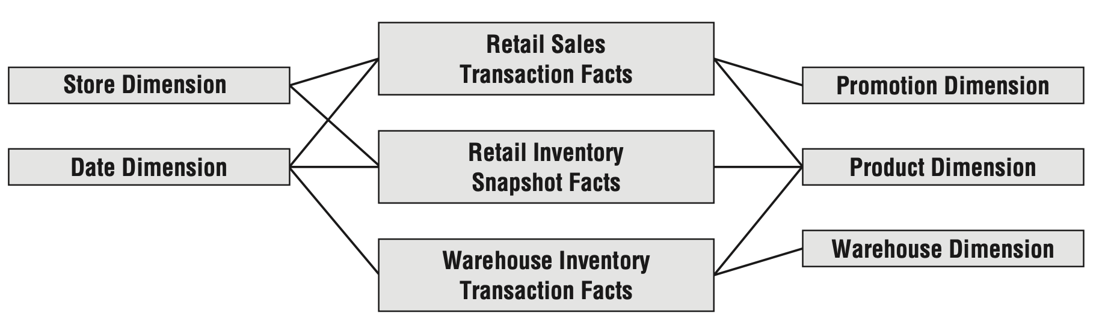
Value Chain Integration
Although separate fact tables in separate dimensional schemas represent the data from each process, the models share several common business dimensions: date, product, and store.

